Slide 1
2021
2021 NOHS
National Conference
Transforming Lives & Communities Through The Power of Human Services
Proposal

Slide 2

2009 NOHS National Conference – Portland, Oregon
2010 NOHS National Conference – Portland, Maine
2011 NOHS National Conference – San Antonio, Texas
2012 NOHS National Conference – Milwaukee, Wisconsin
2013 NOHS National Conference – Baltimore, Maryland
2014 NOHS National Conference – Las Vegas, NV
2015 NOHS National Conference – Charlotte, NC
2016 NOHS National Conference – Tampa, FL
2017 NOHS National Conference – Des Moines, IA
2018 NOHS National Conference – Philadelphia, PA
2019 NOHS National Conference – Anaheim, CA
2009 - 2019
Conferences

Slide 3
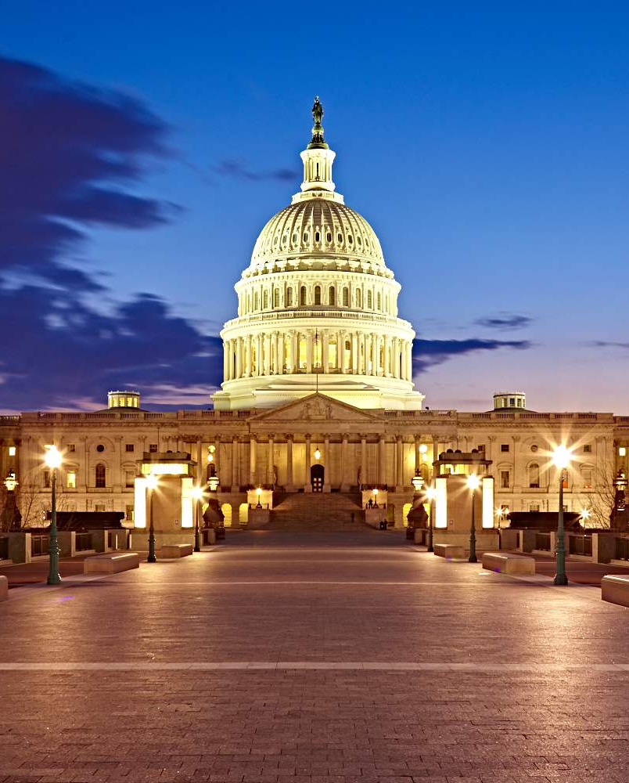
Conference
Overview

Slide 4
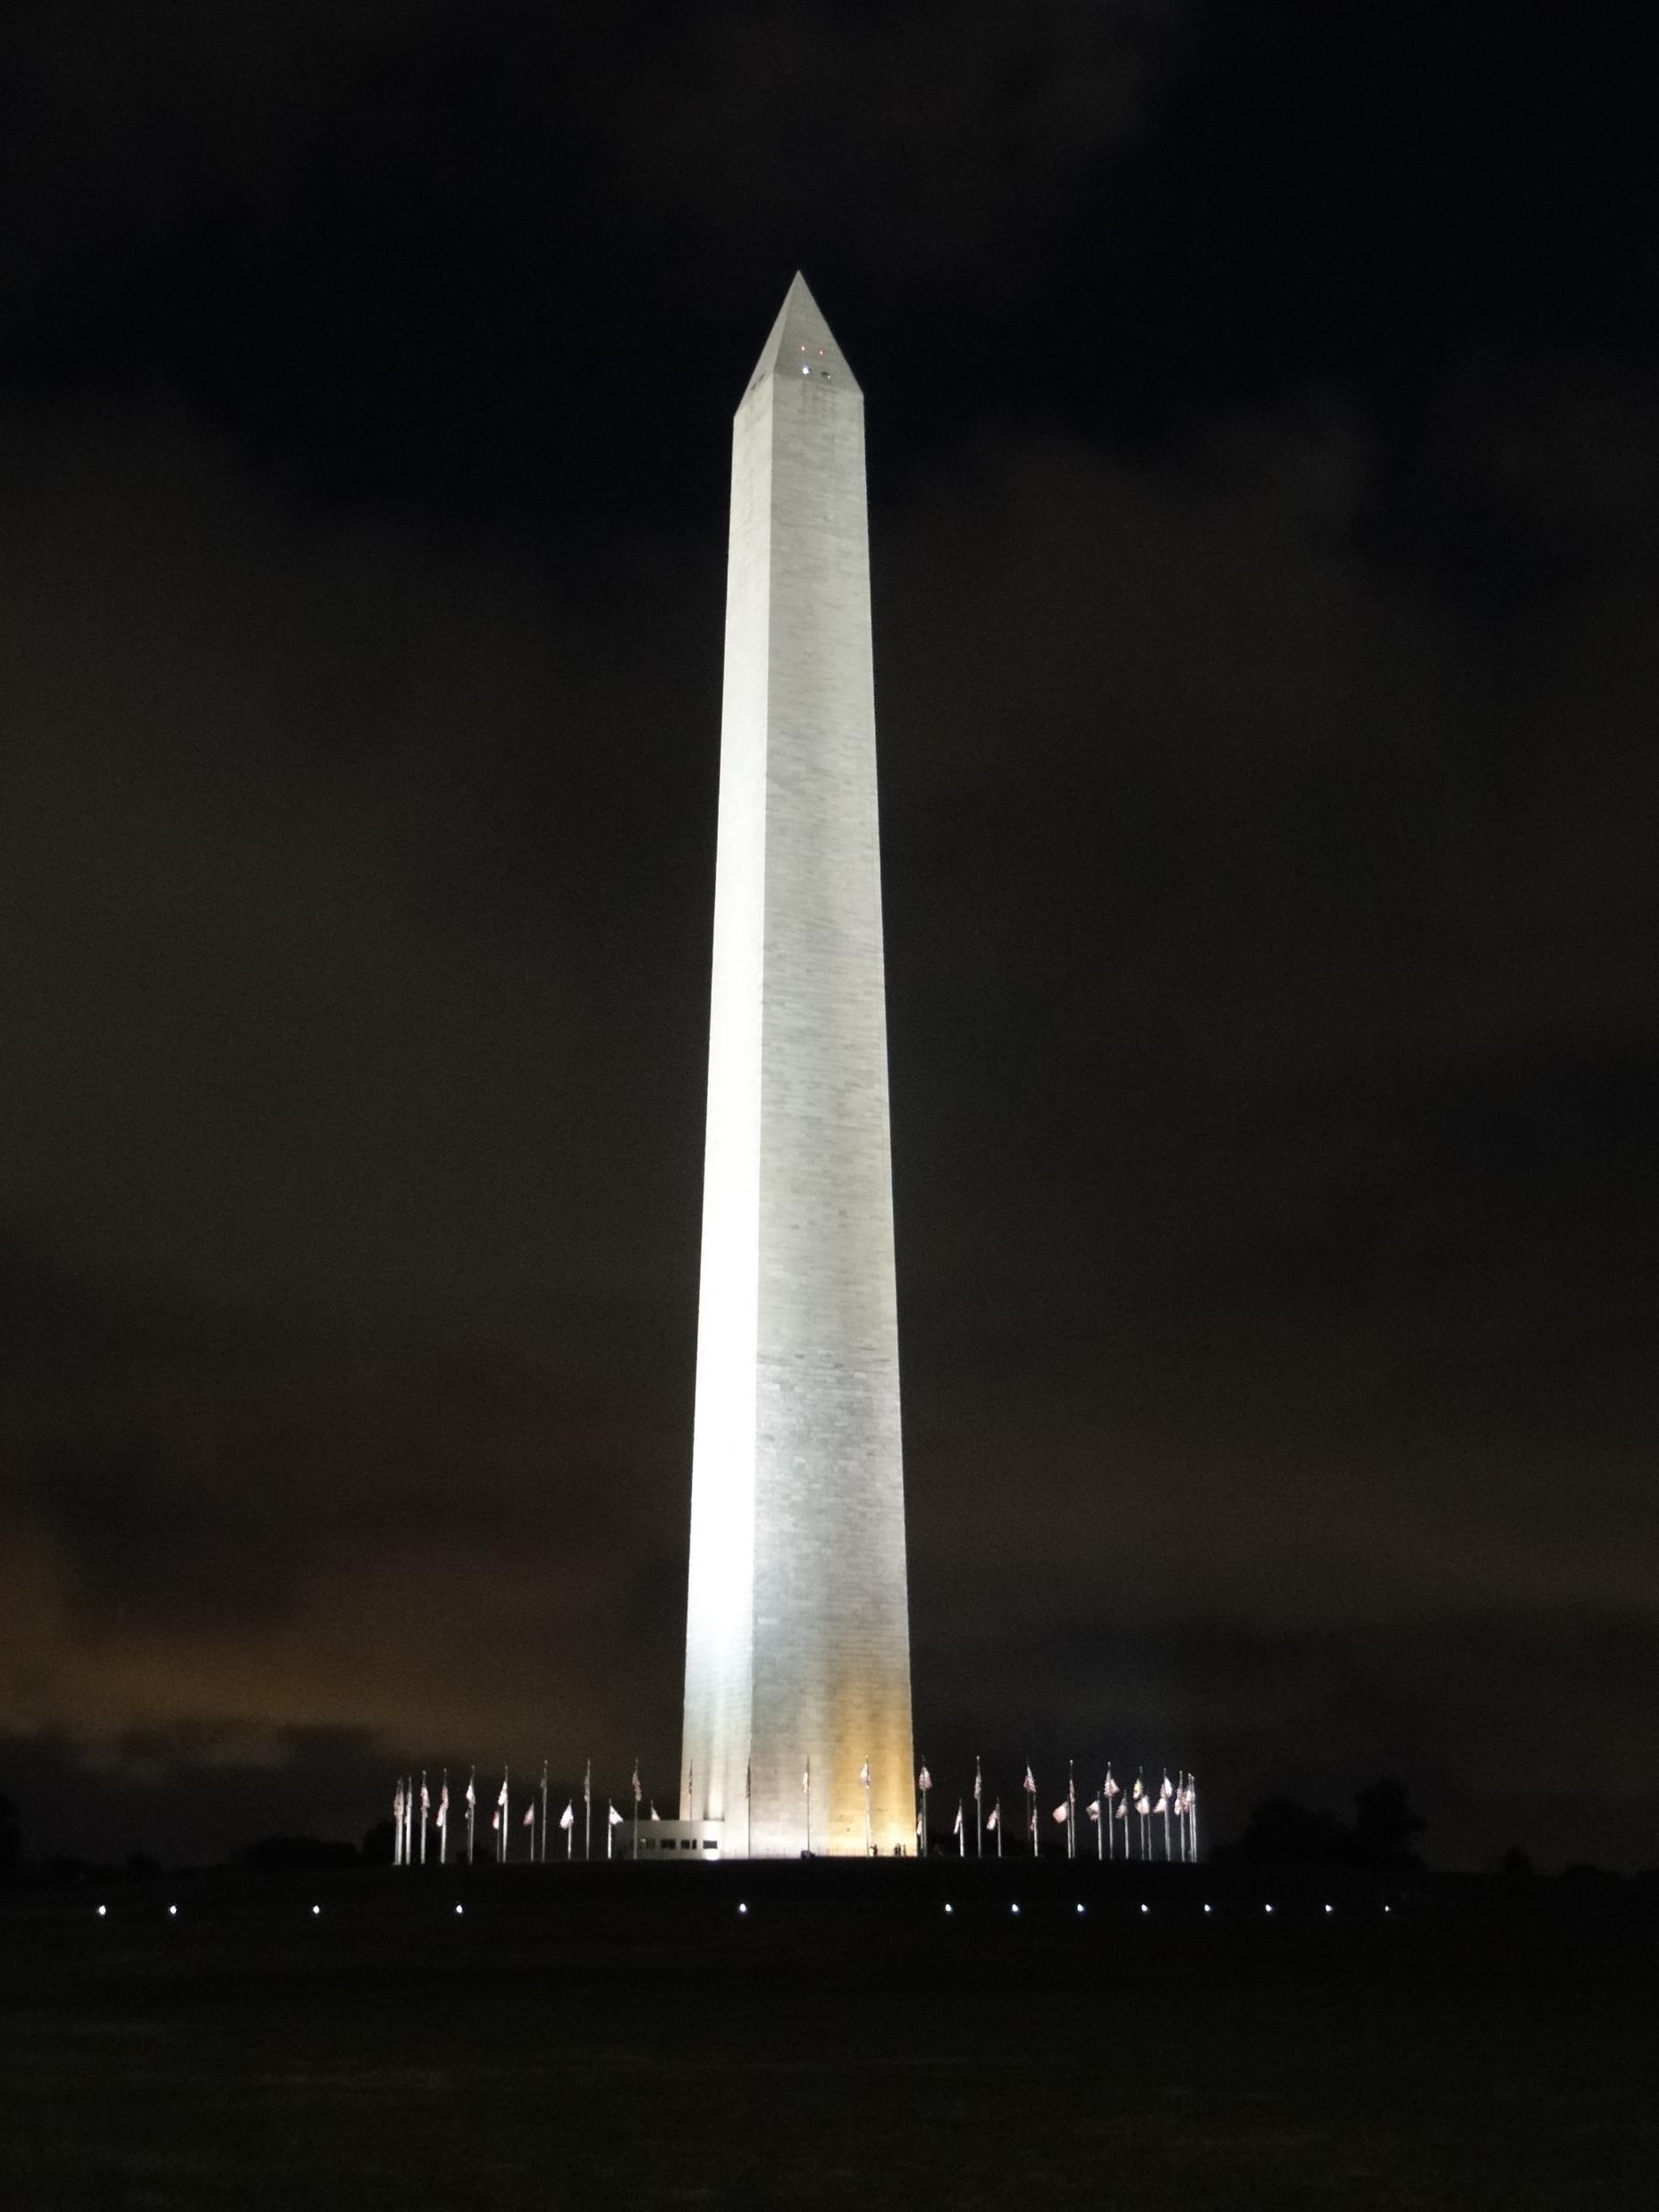
Why Washington, DC?
Washington, DC is not just a smart city where innovators can plug into a world-class technology infrastructure and access, but with 140 miles of bike lanes, dozens of iconic monuments, FREE museums, ready-to-explore neighborhoods, and world-class restaurants, DC is just the place to be.
Washington, DC is a truly global city with a thriving and beautifully diverse local identity at its heart. Home to three major airports, all within miles of the city.
Voted as the #1 City for Women in Tech by SmartAsset.
Voted the #1 City in the World for Entrepreneurial Talent by GTCI.
Ranked #1 park system of US cities according to the Trust for Public Land,
and DC is the first LEED Platinum city in the world.
DC’s walkability and world-class public transportation system makes the city a top choice.
Now is the right time for NOHS to experience the magic of Washington, DC.

Slide 5
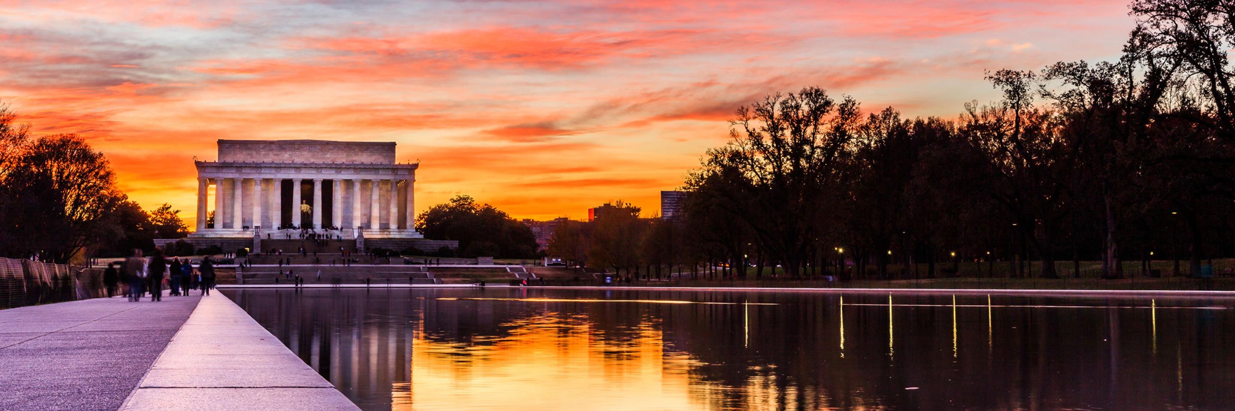
Population: About 702,000 live in DC proper; more than 6.2 million live in the greater DC metro area.
Peak Season: March and June are the busiest months, followed by September and October.
Climate: DC experiences all the seasons: warm summers, cool and sometimes snowy winters and pleasant springs and falls.
Lay of the Land: The Nation’s Capital is located in the MidAtlantic region between Maryland and Virginia, 225 miles south of New York City. Washington, DC is laid out on a grid with quadrants: Northeast, Northwest, Southeast and Southwest. Streets denote their quadrant with NE, NW, SE or SW. The numbered streets run north-south, the lettered streets run east-west and diagonal streets have state names, which adds to the uniqueness of the city.
About DC
Just A Little

Slide 6
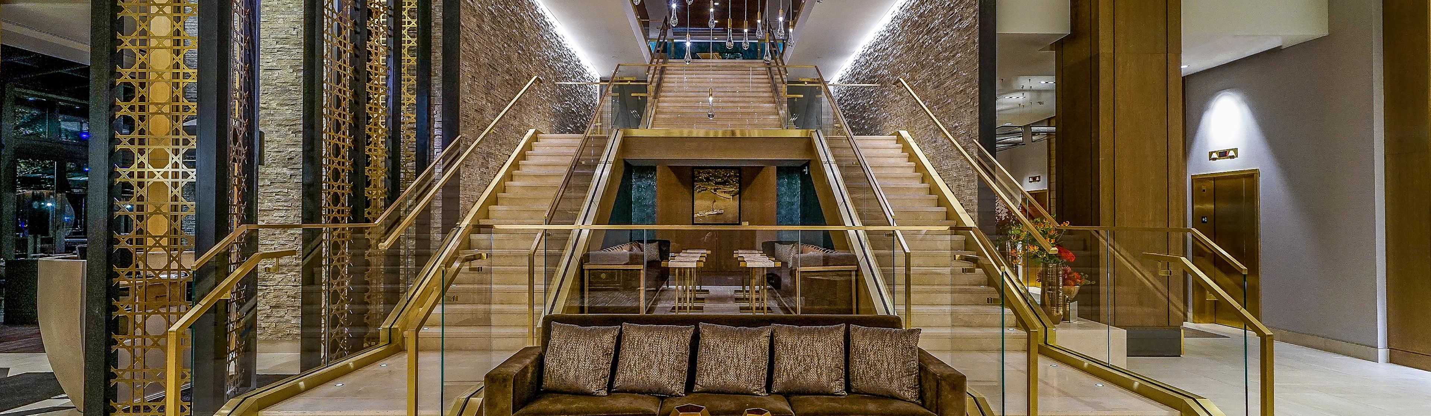
BrightIdea
Few destinations offer as many exciting free things to do as Washington, DC. From awe-inspiring monuments and memorials to world-renowned events, there is something free for everyone to enjoy.
  Witness the majestic monuments and memorials under moonlight – Free.
  Explore 17 Smithsonian museums and galleries, including the National Zoo – Free.
  Experience vital art from Renaissance masters to modern-day marvels at the National Gallery of Art – Free.
  Catch a daily performance at The John F. Kennedy Center for the Performing Arts’ Millennium Stage – Free.
  Check out the magnificent Library of Congress, the largest library in the world – Absolutely Free!
Free in DC
So Many Things are

Slide 7
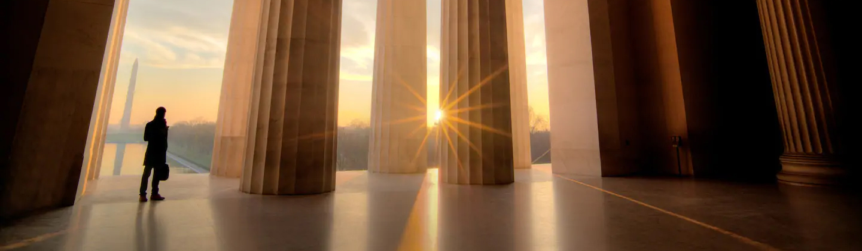
The Number of Nonprofit Organizations in DC:
501(c)(3) Public Charities 8,024
501(c)(3) Private and Public Foundations 497
OTHER 501(c) NONPROFIT ORGANIZATIONS* 3,846
All Nonprofits Organizations 12,367
*Civic Leagues, Chambers of Commerce, Veterans Organizations, etc.
Economic Impact of the D.C. Nonprofit Sector:
Employs 118,100 - over 26% of the state’s workforce
Generates almost $48 billion in annual revenues
Holds assets of $86.7 billion
DC foundations annually give over $417 million
DC residents give over $894 million to charity each year, representing 4 percent of household income
Impact
DC’s Nonprofit

Slide 8
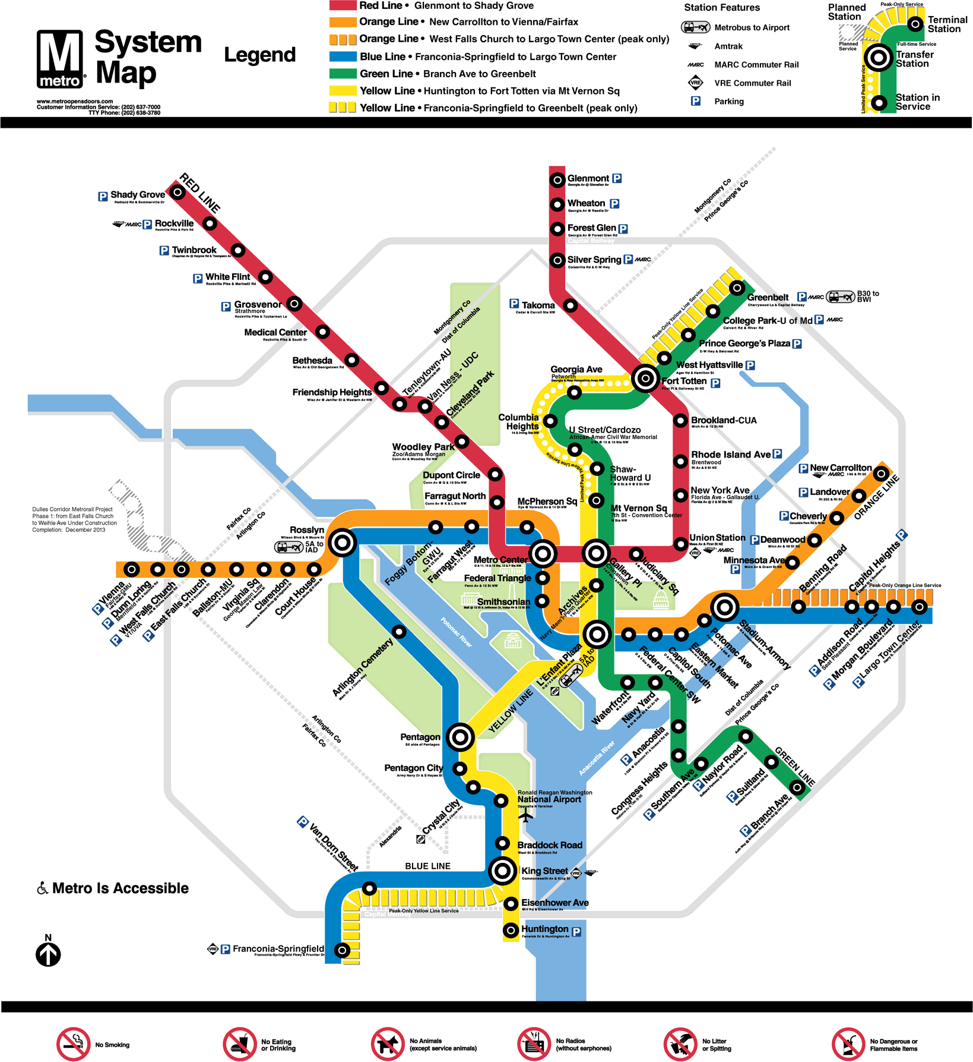
Getting Around
Washington, DC
CARS
Taxis in DC accept credit cards. Fares start at $3.50 and are metered. A 15-20% tip is customary. Uber and Lyft also provide service throughout the metro DC area, and include options ranging from rideshares to luxury SUVs.
ON FOOT
DC has numerous public parks and walkable neighborhoods, making navigation on foot easy. Order a free map today on washington.org.
ON BIKE
Cruise around DC on a battery-powered scooter or one of the bike-sharing systems that serve the area, such as Capital Bikeshare. You can also rent wheels and a helmet from Bike and Roll DC.
METRO
Metro transit services make DC accessible and easy to navigate. The underground train and citywide bus system (Metrorail and Metrobus) serve the area. Most major hotels and attractions are near Metrorail stops. Tip: The new Silver Line is projected to connect to Dulles International Airport in July 2020

Slide 9
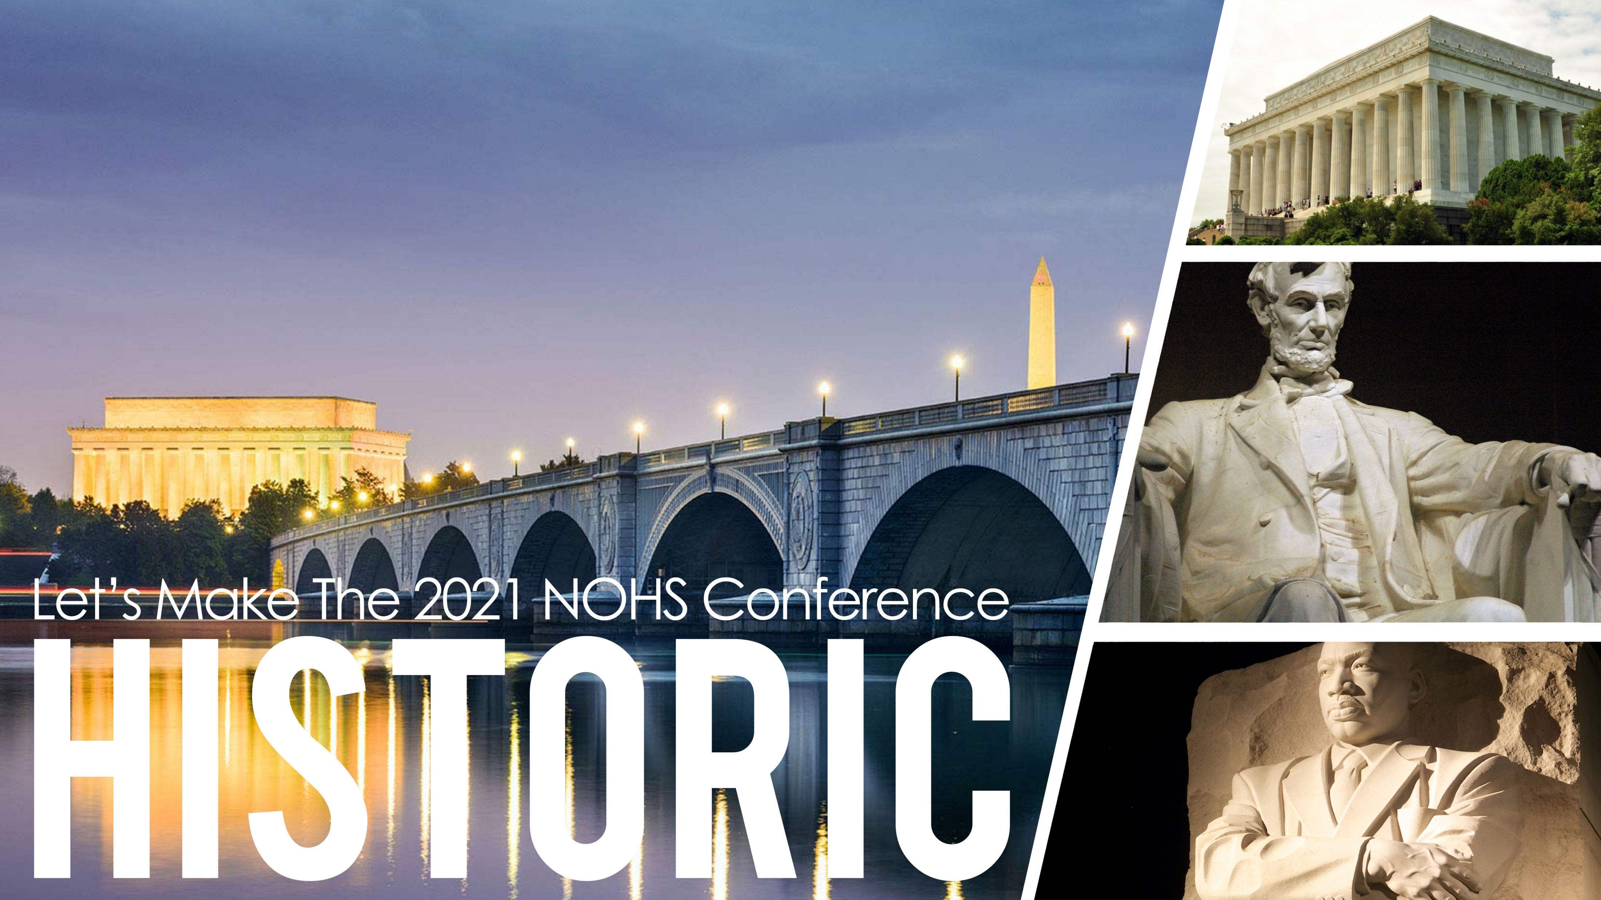

Slide 10
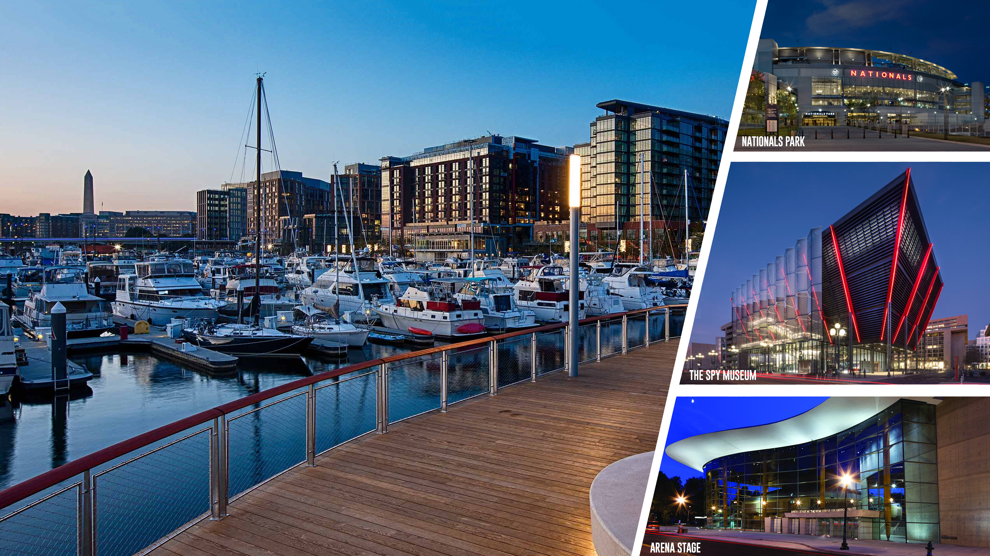


Slide 11
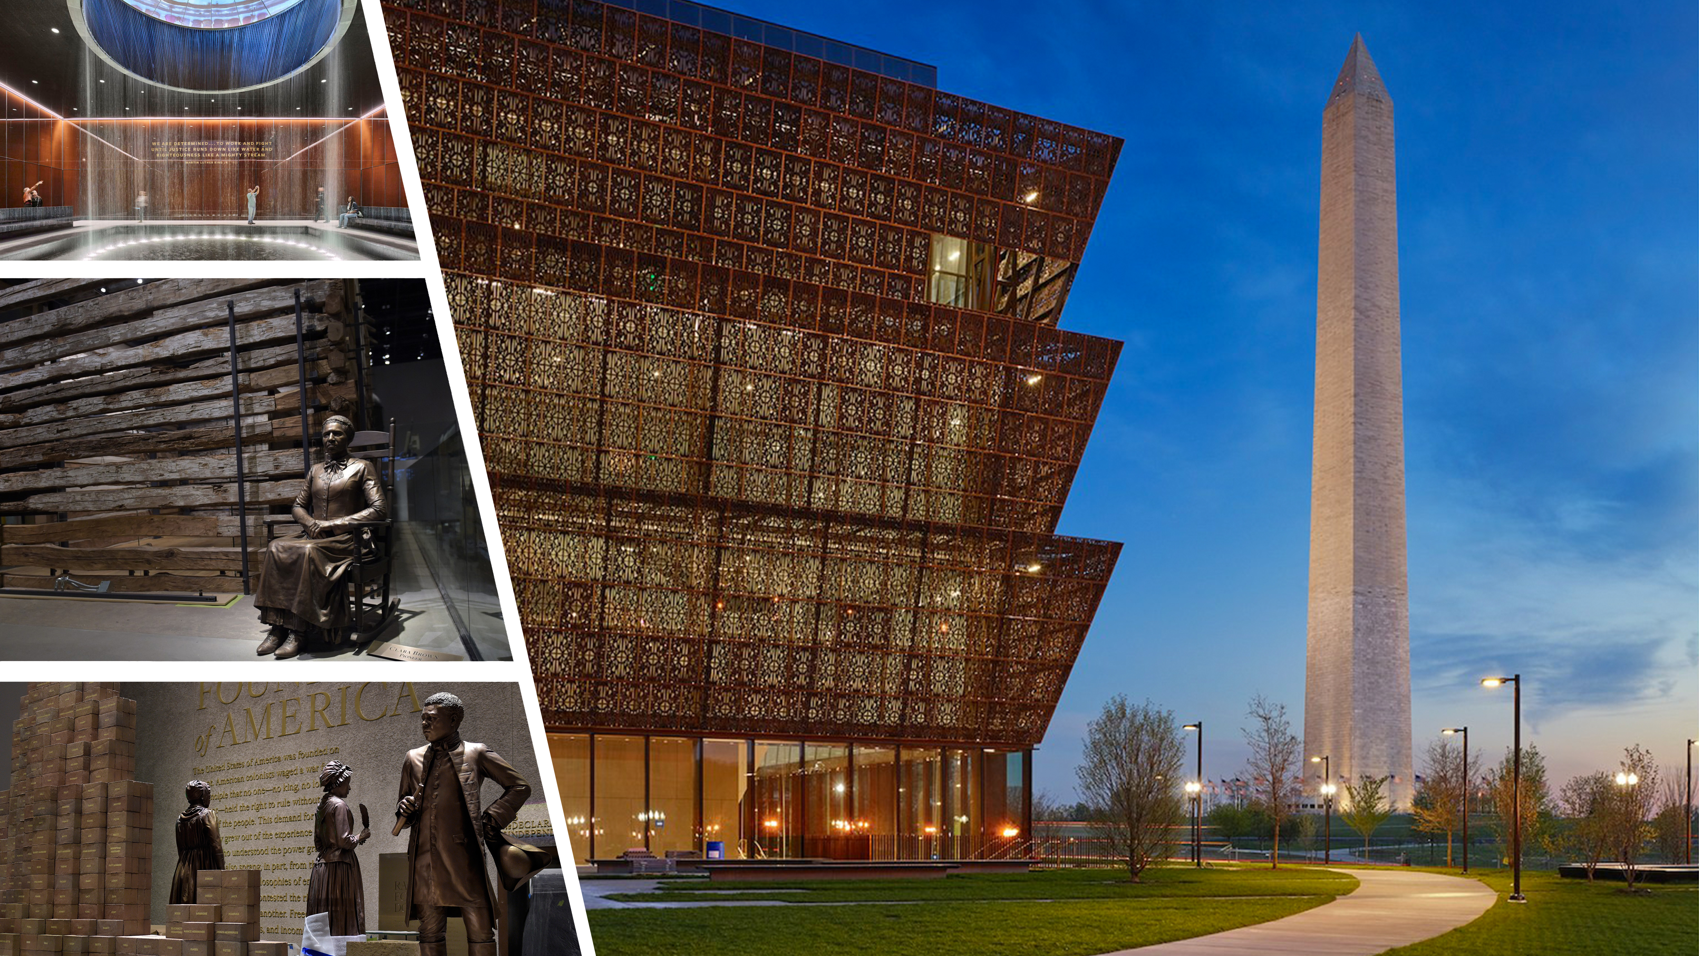

Slide 12
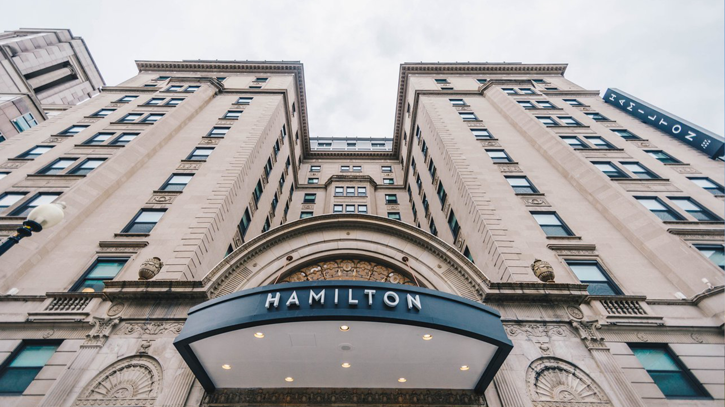
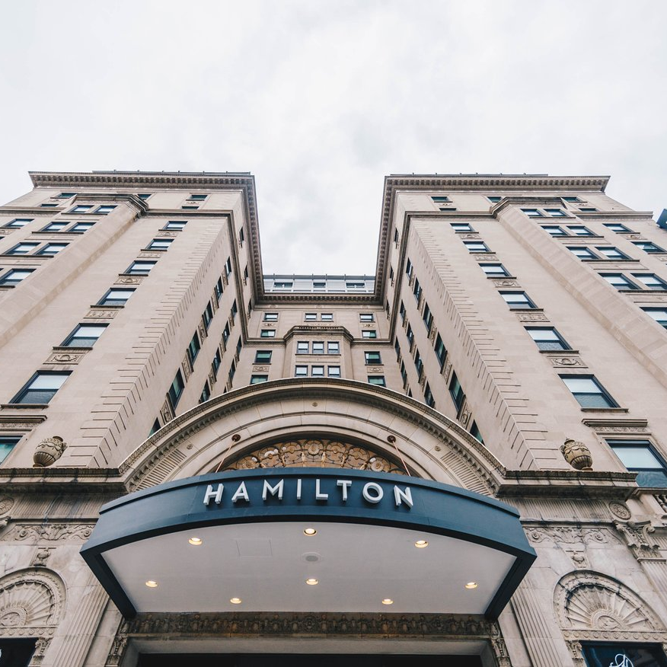
OUR TOP 5
HOTELS
An Extremely DIVERSE City
Washington, DC accommodations range from the most opulent, award winning hotels to chic, stylish boutique properties to reliable, comfortable and budget-friendly brands. We can draw from a variety of accessible, exciting choices: Host our conference in the center of the city in an eclectic, energetic neighborhood or in a quiet, historic community.
Over 32,000
Hotels

Slide 13
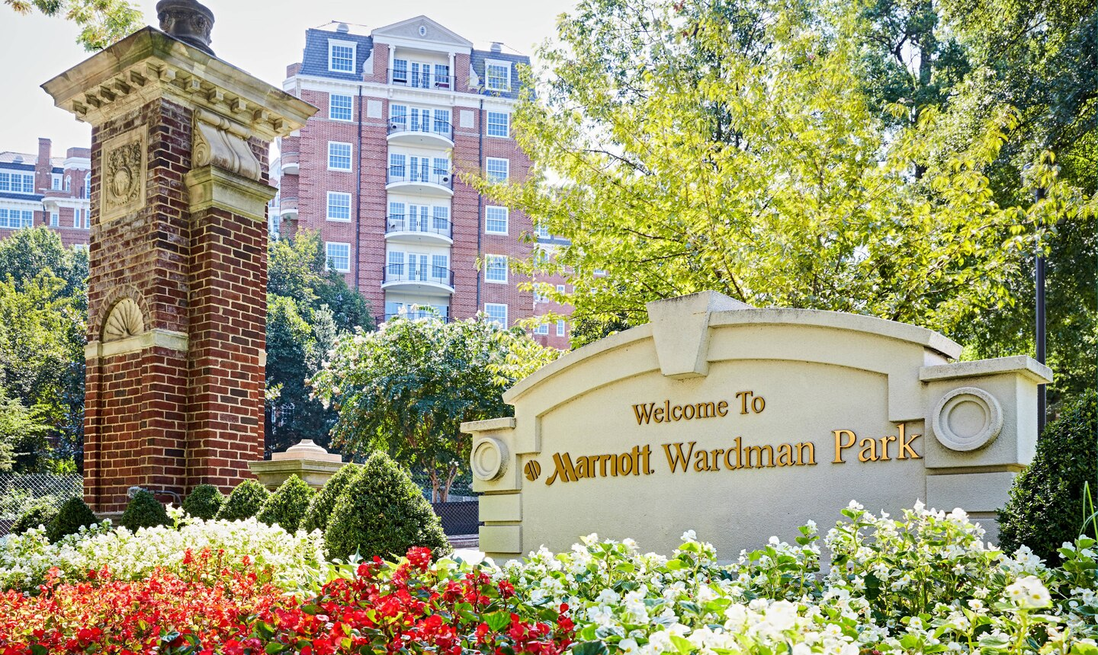
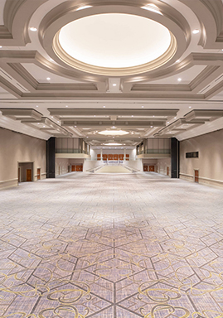
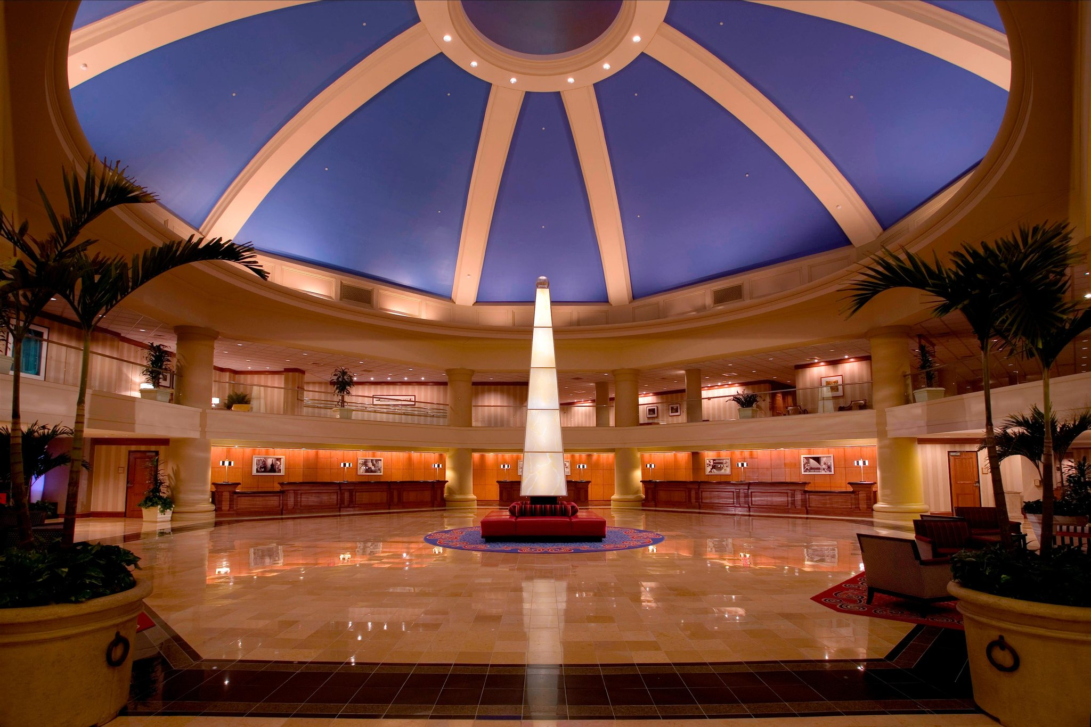
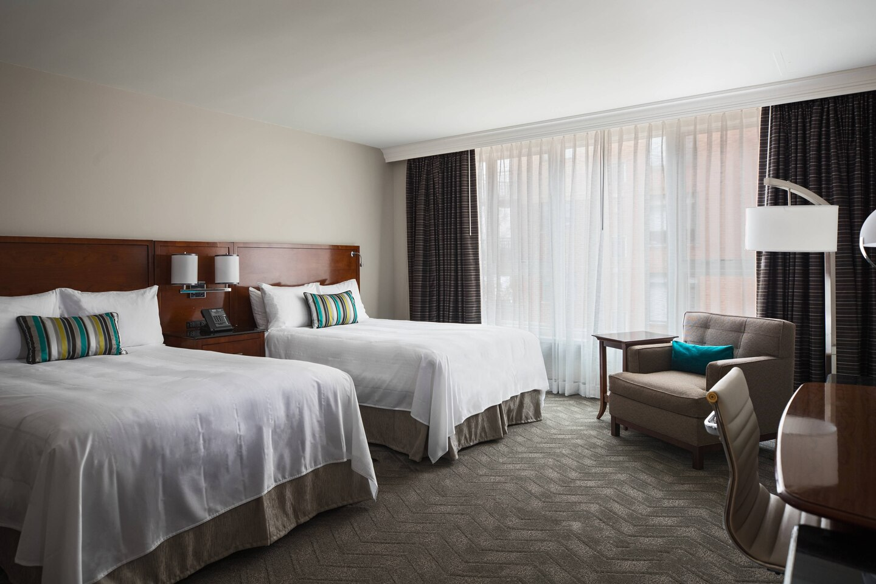
Washington Marriott
Wardman Park
2660 Woodley Rd NW, Washington, DC
Guest Rooms
1,150
Location
Washington, DC
Meeting Rooms
64
Landmarks
National Zoo
National Cathedral
Embassy Row
Cost
$$$

Slide 14
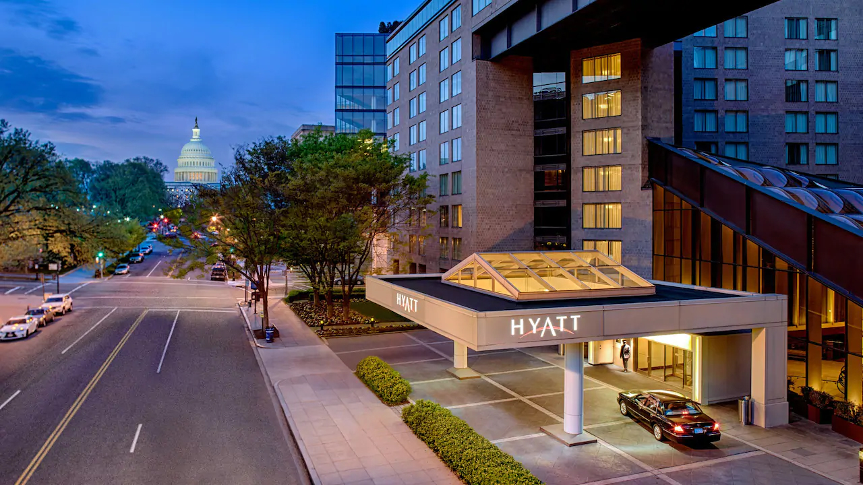
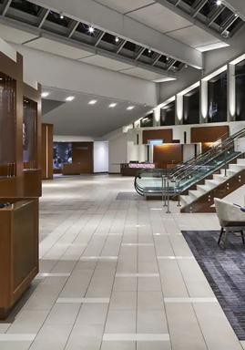


Hyatt Regency Washington
on Capitol Hill
400 New Jersey Ave NW, Washington, DC
Guest Rooms
838
Location
Washington, DC
Meeting Rooms
32
Landmarks
US Capital
Smithsonian Institution
Kennedy Center
Cost
$$$

Slide 15
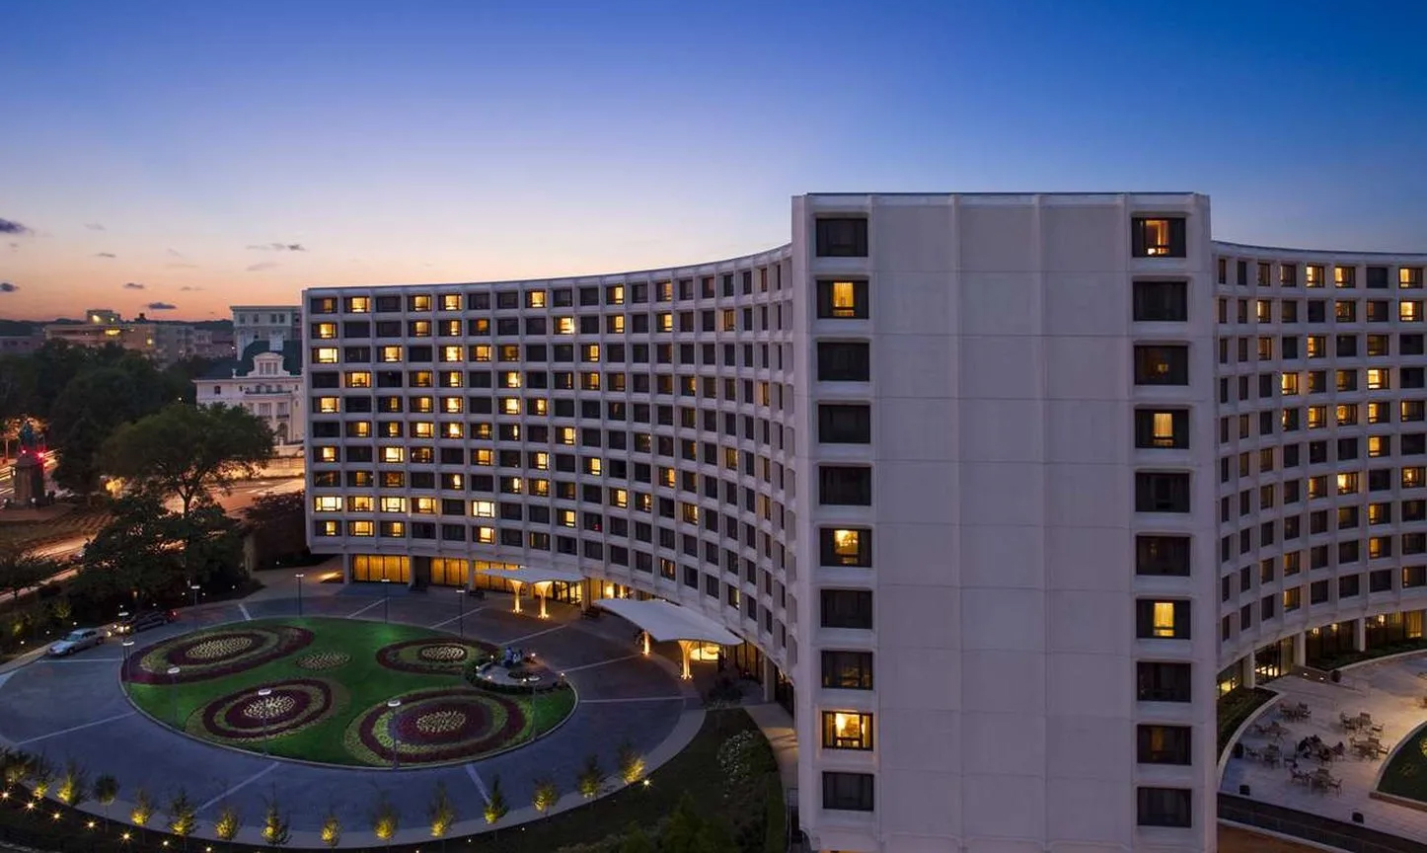
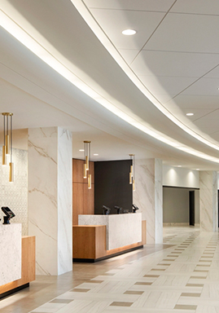

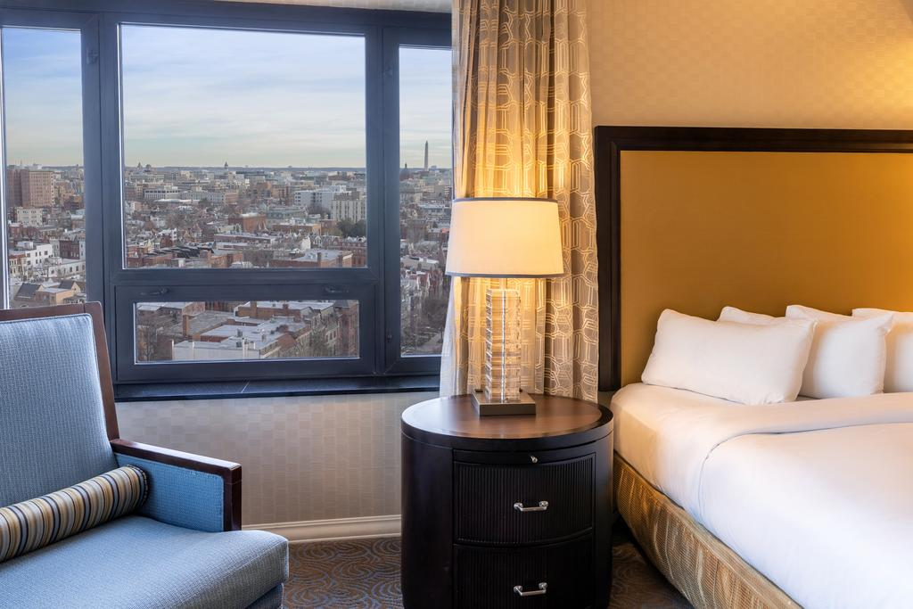
Washington Hilton
1919 Connecticut Ave NW, Washington, DC
Guest Rooms
1,107
Location
Washington, DC
Meeting Rooms
81
Landmarks
National Zoo
White House
Embassy Row
Cost
$$

Slide 16
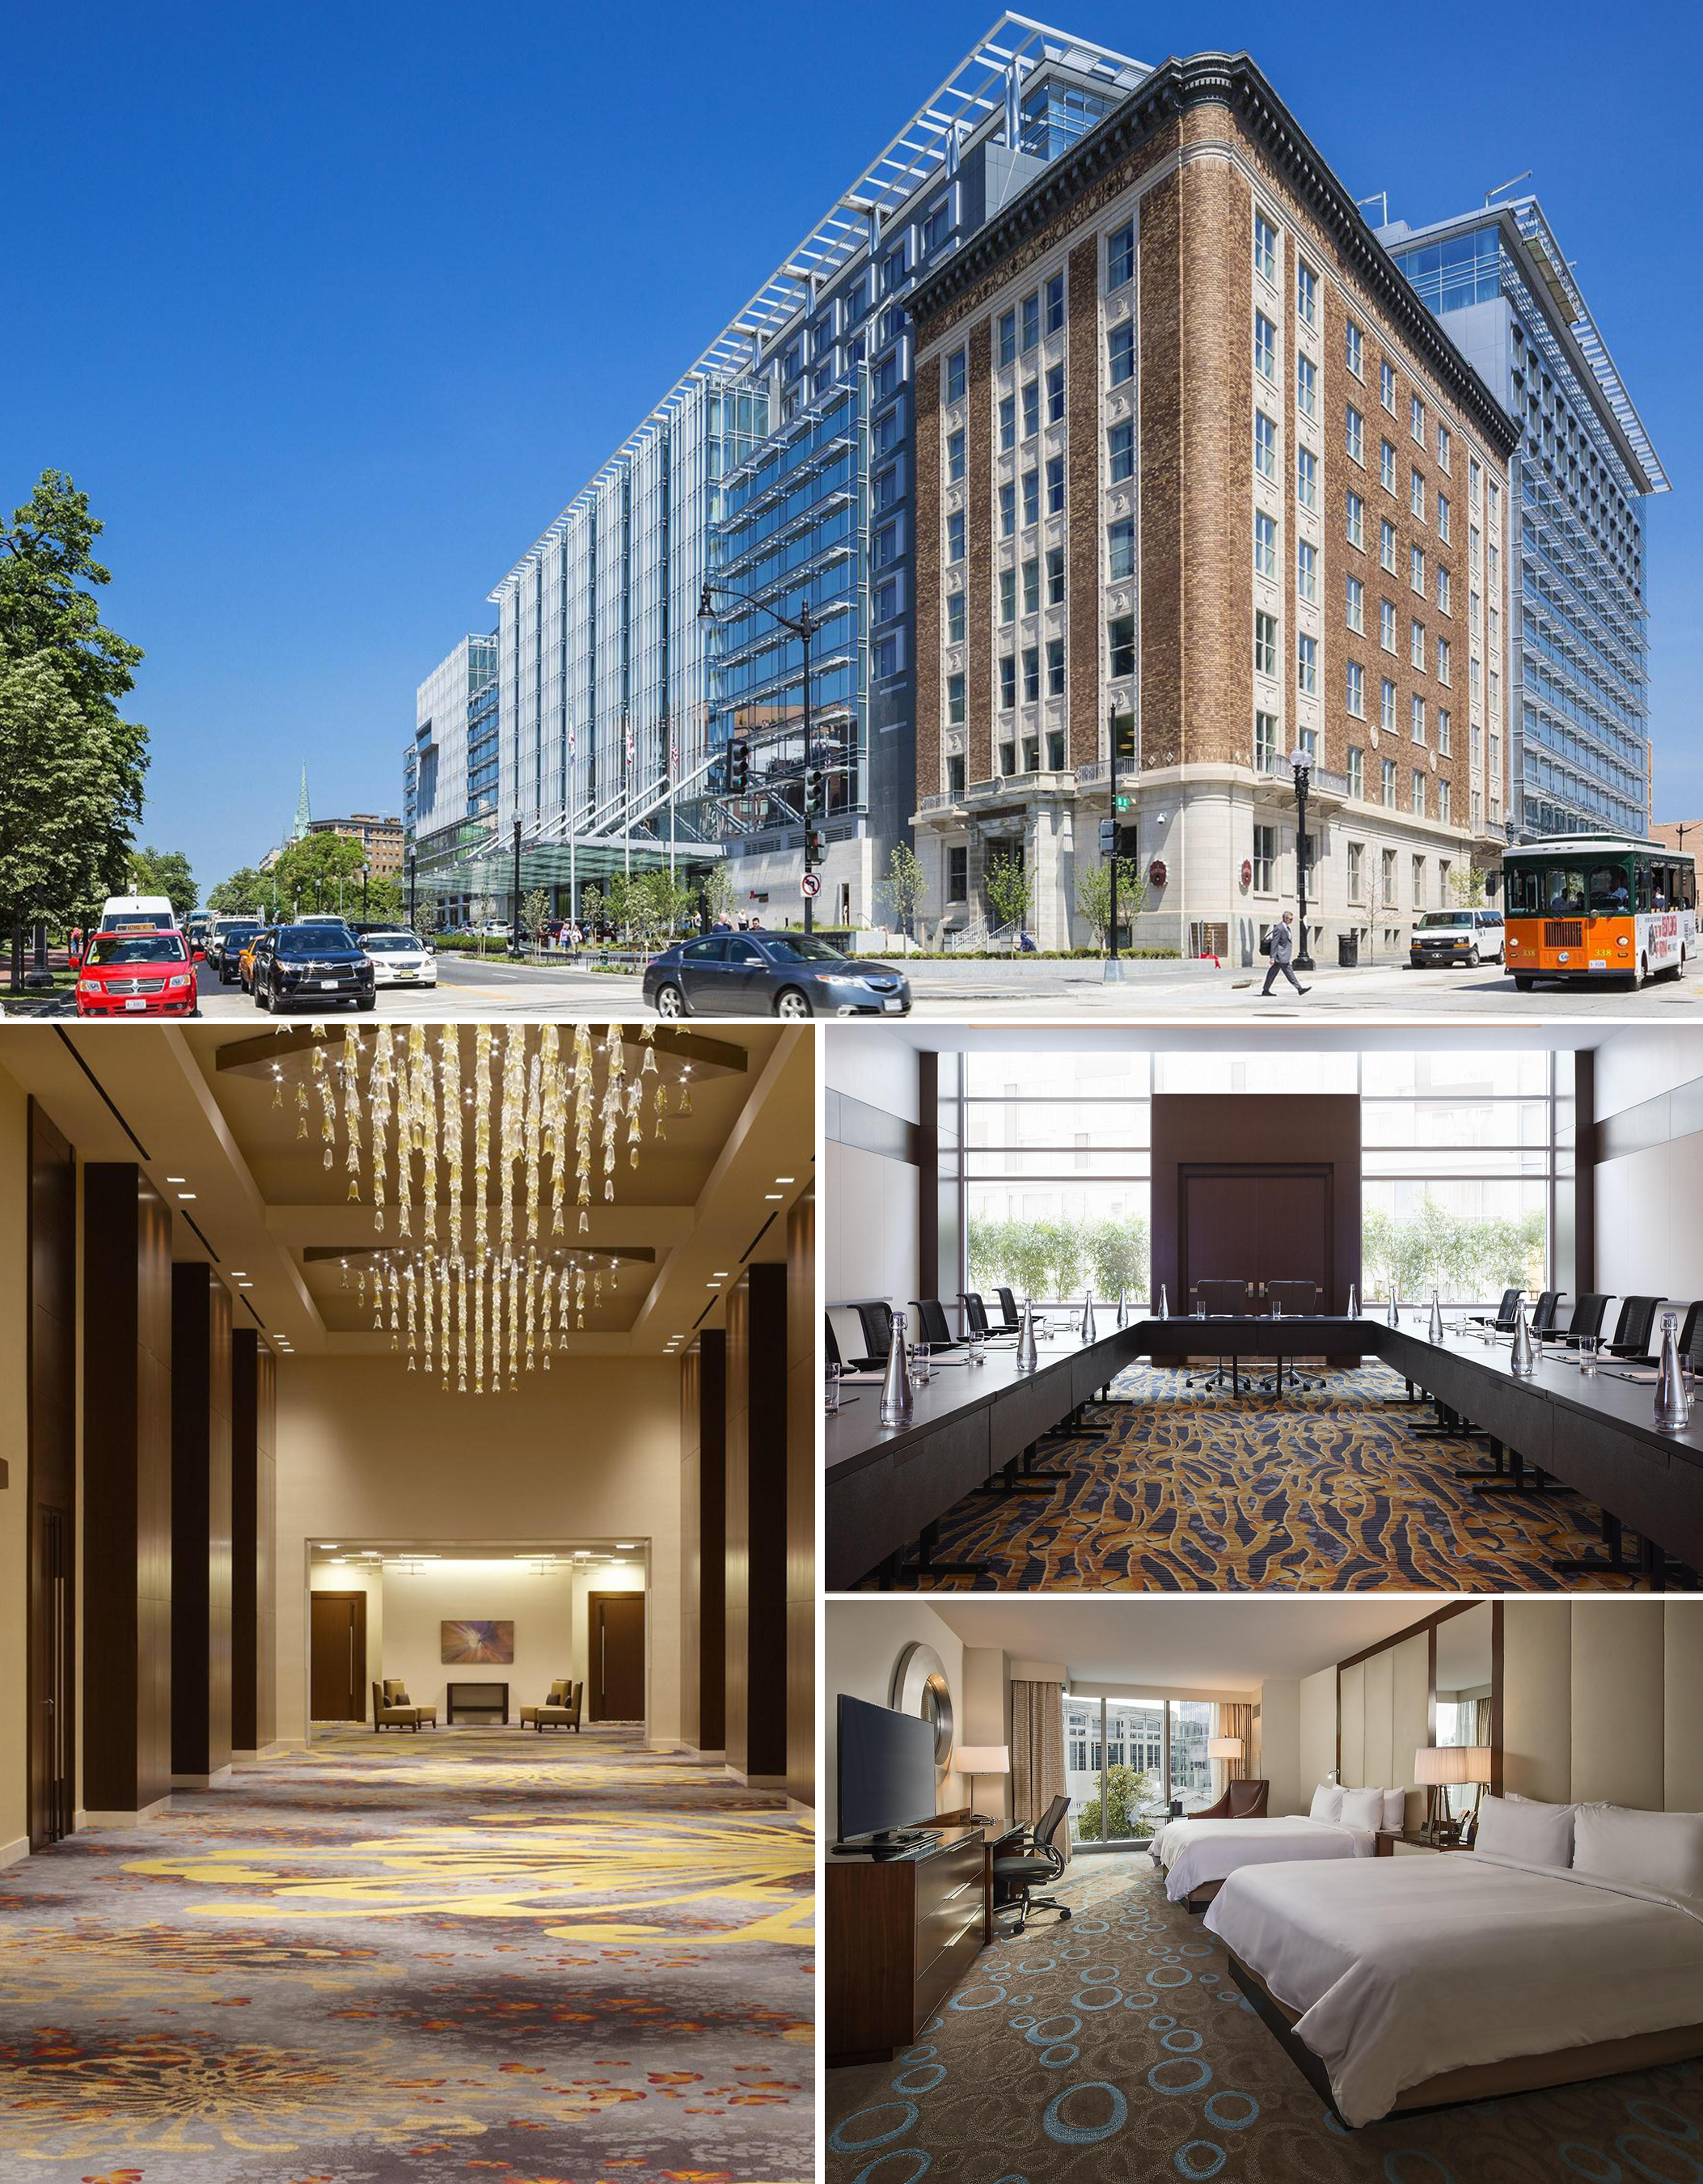
Marriott Marquis
Washington, DC
901 Massachusetts Ave NW, Washington, DC
Guest Rooms
1,175
Location
Washington, DC
Meeting Rooms
80
Landmarks
The White House
The US Capitol
Library of Congress
Washington Monument
The Smithsonian Museums
Cost
$$$

Slide 17
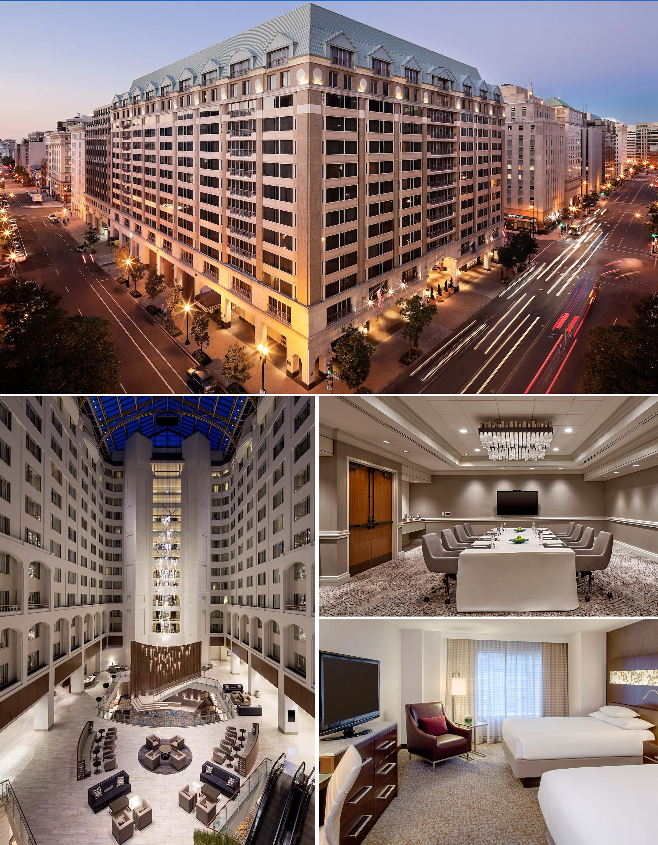
Grand Hyatt
Washington
1000 H St NW, Washington, DC
Guest Rooms
897
Location
Washington, DC
Meeting Rooms
39
Landmarks
The White House
The US Capitol
Library of Congress
Washington Monument
The Smithsonian Museums
Cost
$$

Slide 18

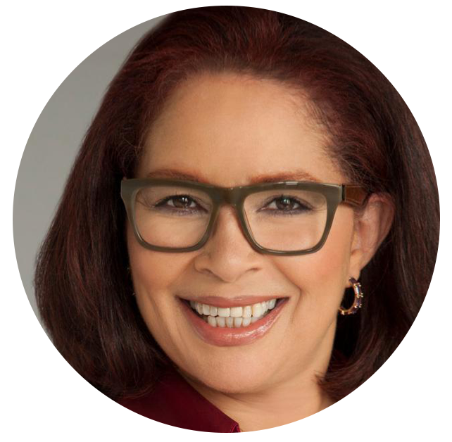
Meet the 2021 NOHS
Conference Coordinator
Janine
Spinola Taylor, EdD.
Janine Spinola Taylor has over 20 years experience in non-profit, for profit, federal, and state government agencies for the following agencies: Internal Revenue Service and Executive Office of Health and Human Services as an auditor for Medicaid and revenue manager for the Commonwealth of Massachusetts wherein she managed 691 million dollars. She has conducted youth workshops entitled “Why are you afraid to be a Lady?” Janine was co-presenter with her son Henry for Boston Public School’s Bridging the Gap Conference. Together they addressed family engagement and their workshop was titled “Collages, Mosaics and Tiles.” She served two years as program coordinator for the Coca-Cola Pre-College Leadership Program at Morehouse College, which serves 30 young men selected for participation across the United States. Her oral history is registered in the United States Library of Congress. Presently, she serves as Assistant Professor at Springfield College, School of Social Work and Behavioral Sciences whereby she is the progenitor of the Organizational Leadership program.

Slide 19

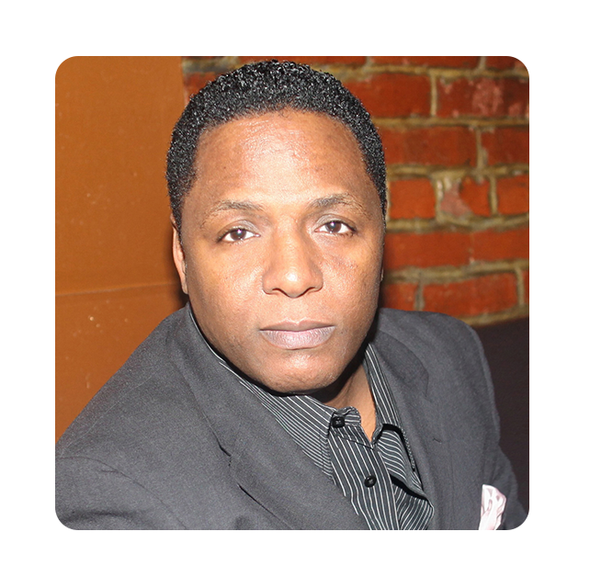

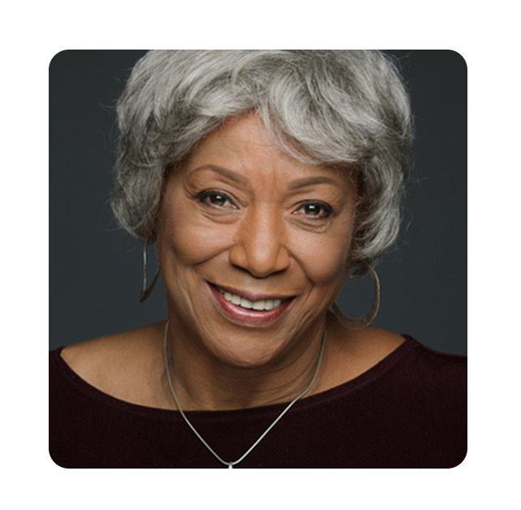
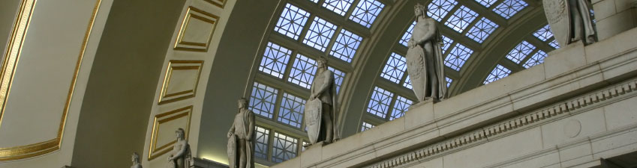
Meet the 2021 NOHS
DC Scouting Committee
Glenn Kinnard-Brown
Diane Fleming
Dr. Dolly Turner
Deputy Director
National Center for Juvenile Justice Reform
Program Coordinator
Community Impact Center
President
Family Strengthening Collaborative

Slide 20
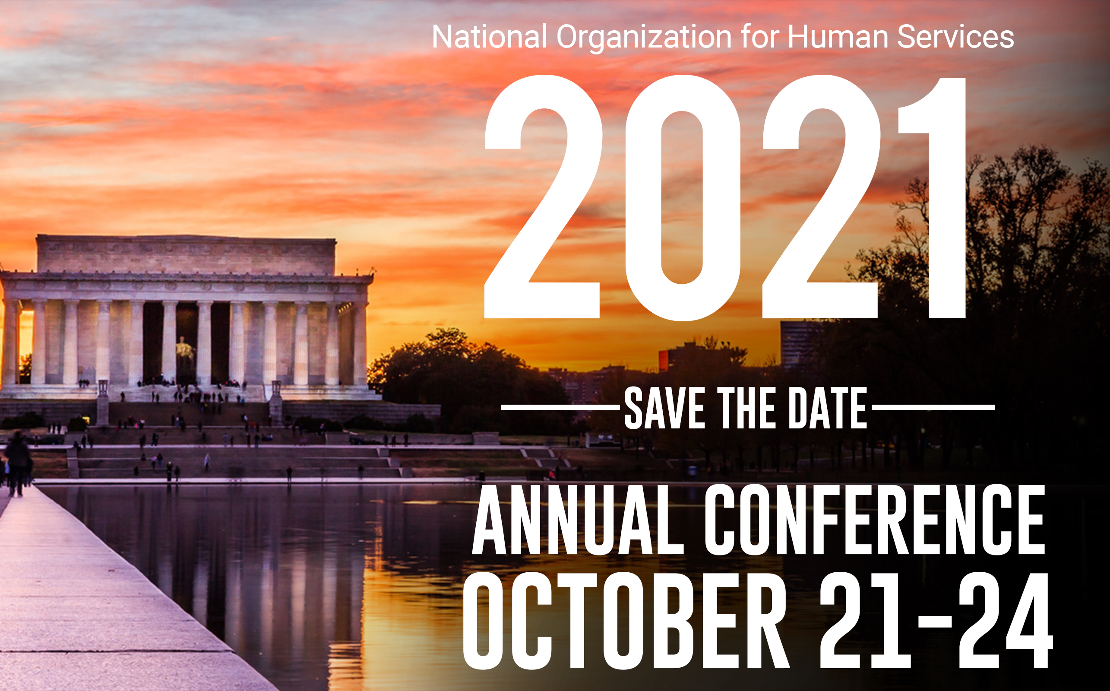

Slide 21
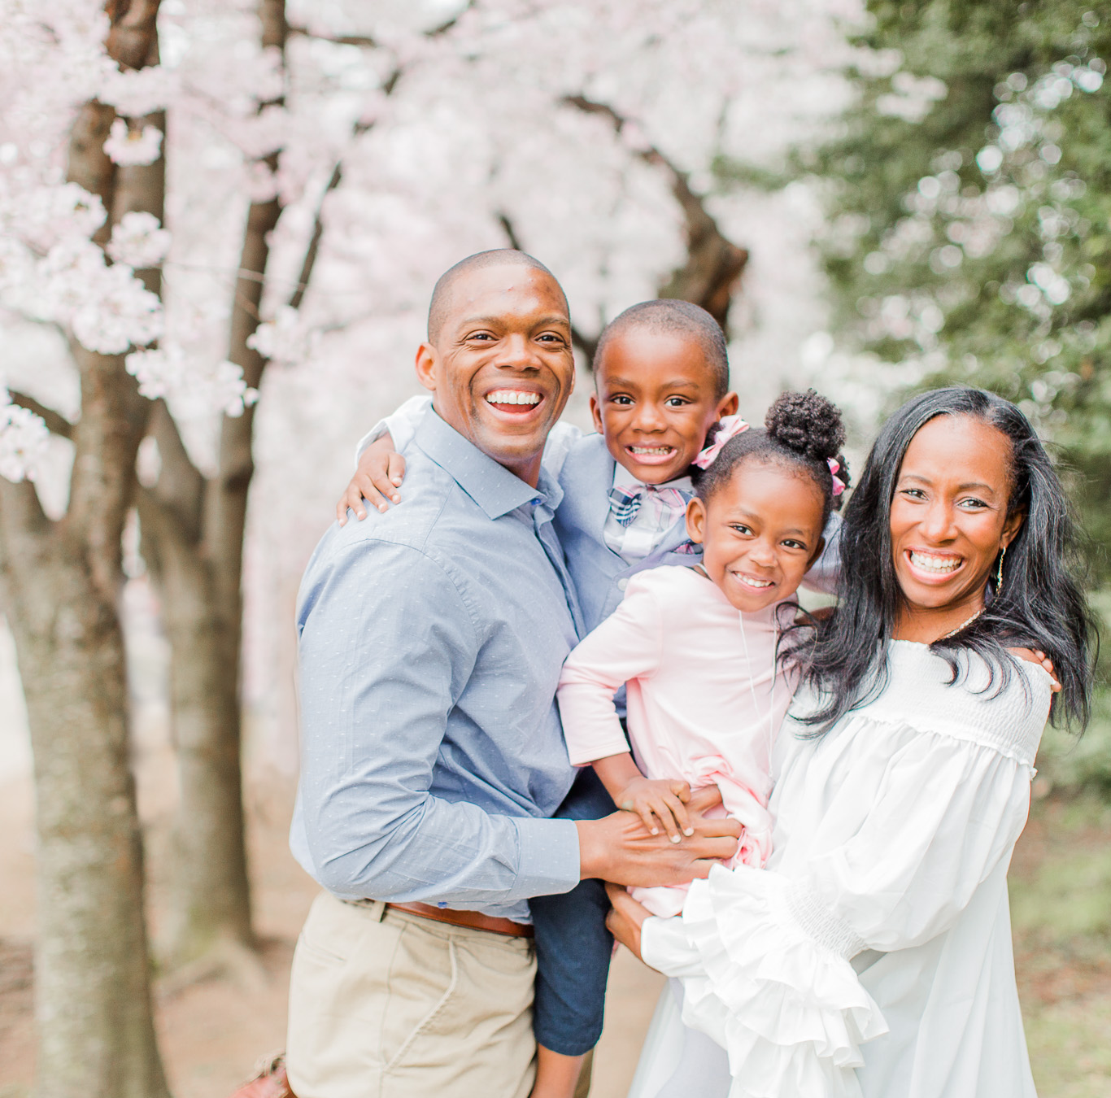

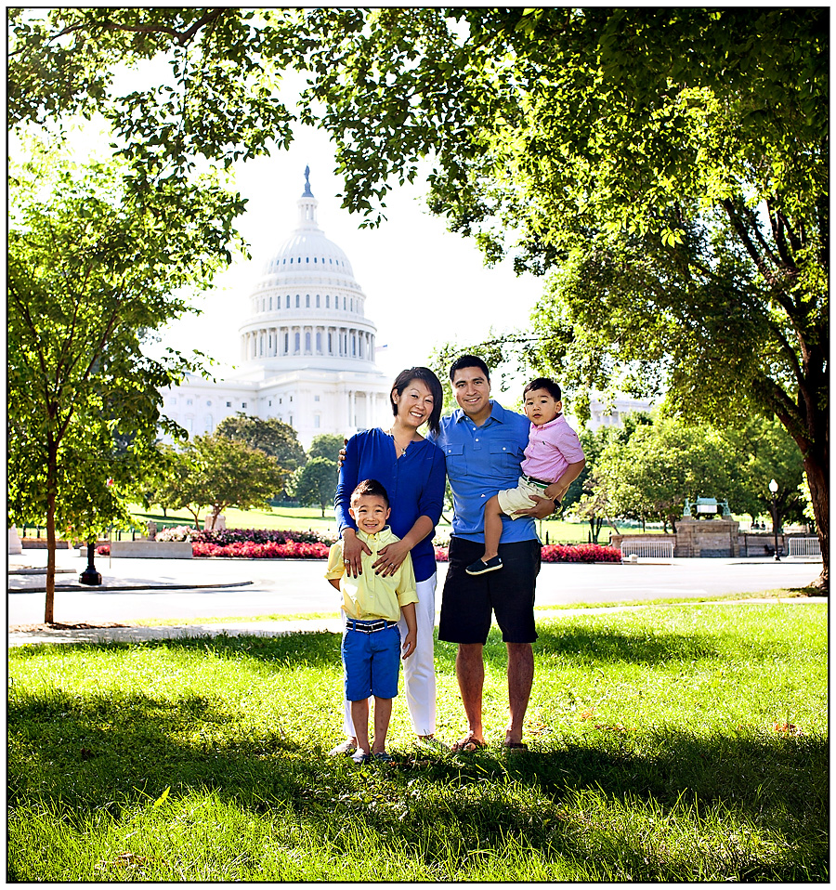


Slide 22
Bring The Family
Stay For The Conference

